Slide 1
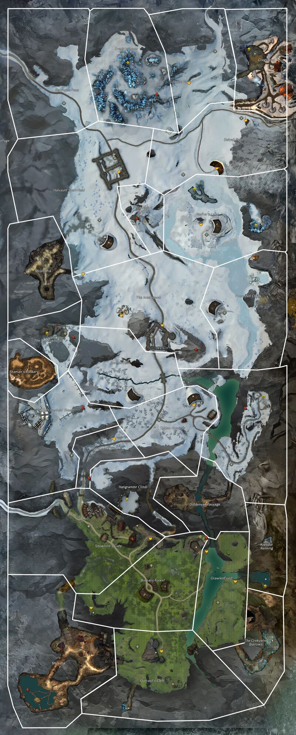
1-welcome slayer, spread the tale of your victory to the other shamans
2-look at you, adding glory to your tale, check on wolf next
3-what wolf is fending off a Svanir attack? Head south and find where they have gained a foothold
4-a bloody dragon totem. And what is this? An attack on bear? Quickly we must not let another spirit fall
5-hrmm this splinter group must have come from somewhere, head through the northern pass and lets see if we can find their camp
6- look there to the east, I see savnir along the ridge, Lets go and show them what it means to betray the spirits
7- Plans for an unholy abomination, quickly we must head to ravens nest and recover an artifact to take down the beast
8- ahh ravens nest. A vault? A rite of passage? Either way, we must get that artifact
9-get anything from that chest? Hrmm, broken? let me have it. Lets take it over to Twinspur Haven to see if someone can repair it. gear up to take it to the savnir
10- I found someone who can repair it, but they need ore from the mine? Good, lets start by checking on the mine to the north west.
11-dredge, what pests. Well lets see if we can go “recover” some metal from their grasp.
12- Good I was able to get some processe ore. Ill head over to Edenvar’s and see if we can find a runner.
13-I was able to get one of these mercs to carry the ore back. They mentioned savnir just to the north east, lets quickly head over and bust some skulls
14-Good, one less savnir means one less headache. Lets see if Krennak needs a hand.
15-An ice giant? Hang around to see if you want to add another scar to your legend or lets move on another lead to the east.
16- a corrupted spike? This only comes from a creature whos soul has been tormented by Jormag. Quickly! We must find and put down this beast. There was Lionguard outpost just north of the wurm cave. Lets see if they know about anything
17-Whispers and screams in the night roll off the hills of the once great Dragonblest. We must push into the ruined town and see if we can stop whatever Jormag has been doing
18-what a foul creature and look here, the corruption of Jormag. Lets hope that this slows down the spread of any more corrupted shards. The once great ruler of this hovel fell, so close to our capital. Lets head west and see how bad Jormag’s voice has spread.
19-Garm smells a foul breeze and the spirits seem unruley, it does not boad well for what we will find in Snowden drifts, but all great heros need a challenge.
18
19
17
14
13
15
16
12
11
10
9
8
7
6
1
5
2
3
4

Slide 2
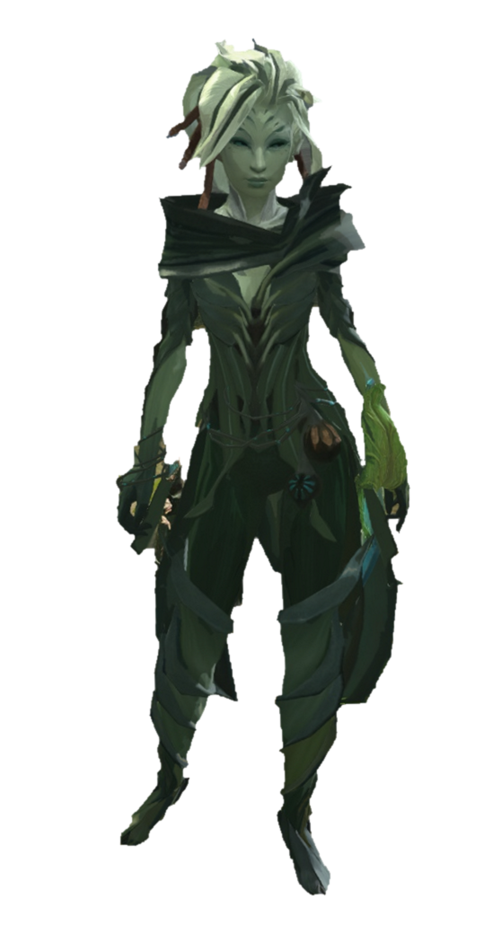

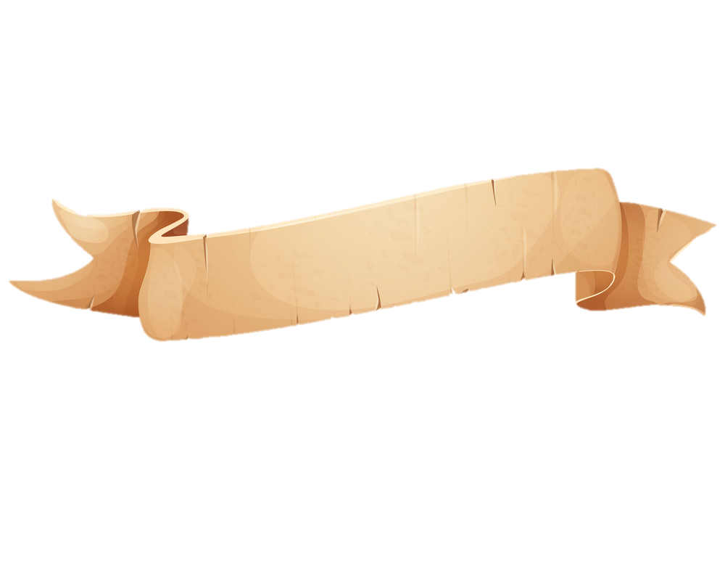
Well, if it isn’t the new “hero”. I hope that knock to your head didn’t do any permanent damage. Logan asked me to come help out but…I’ve been distracted watching that beautiful woman. She is in quite the “Diah-lema”, but I didn’t bring my working clothes. Help her out and come find me by the river.
Somehow its always bandits and this close to home. Let’s check on Flannum and make sure they haven’t done any “dam-age”. Alright, alright, I’ll stop.
You check the north side, and I’ll check the south. Meet you at the western shore.
3
2
Faren

Slide 3
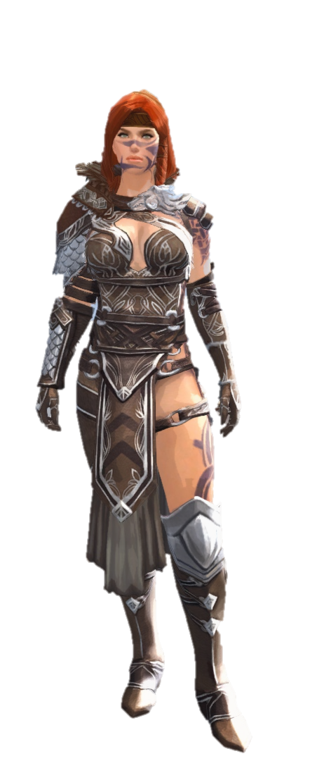
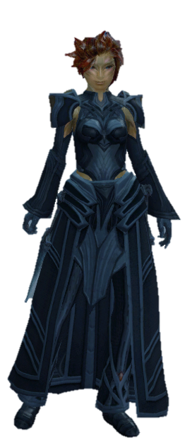

Slide 4
